Slide 1


Data Maturity Project presentation
1
Campus Geel, Kleinhoefstraat 4, BE-2440 Geel

Slide 2
Table of contents
01
03
04
Introduction
02
Project plan
GCP Cost
Dashboard
2

Slide 3
01
Introduction
3

Slide 4
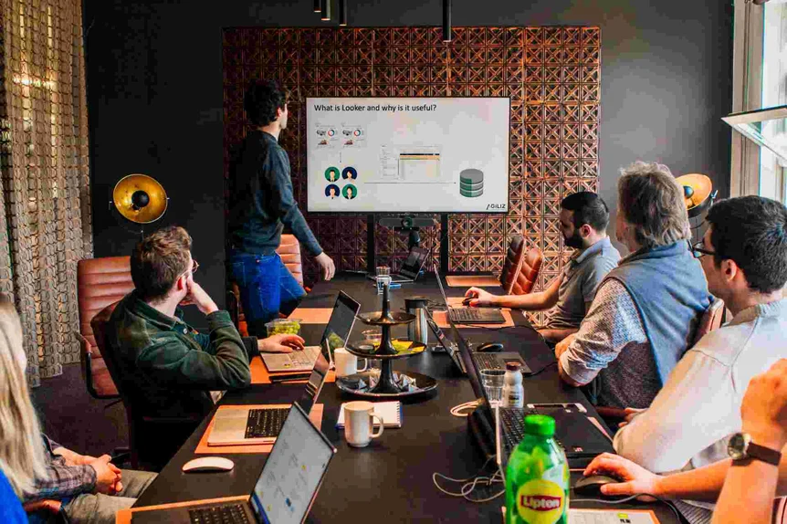
Purpose
Do you know what helps streamline data management? Our project "Data Maturity" does just that:
It provides a structured questionnaire covering various aspects of data management.
Participants submit responses via Google Forms.
Data is processed through a Google Cloud pipeline and visualized in a Dashboard.
Efficient cleaning and real-time processing of questionnaire data are crucial to ensure immediate actionable insights.
4
Notes:
Our project, named "Data Maturity," aims to help companies assess their data management capabilities through a structured questionnaire covering areas such as data journey, empowerment, data culture, data activation, and data governance. Participants submit their responses via Google Forms, which are then processed through a Google Cloud pipeline and showcased in Dashboard to visualize the results. the primary obstacle here is the efficient cleaning and real-time processing of questionnaire data. This ensures that actionable insights are immediately available upon submission.

Slide 5
Objectives
Real-time Data Processing
"Enable instant processing of Google Forms responses using Google Cloud tech."
Data Cleaning and Preparation
"Automate data cleaning for consistency and standardized format, handling missing values and ensuring uniformity."
Dynamic Dashboard Creation
"Employ Looker for real-time dynamic dashboards, illustrating data maturity levels and identifying strengths and areas for improvement."
User Experience Optimization
5
Ensure that the questionnaire is user-friendly and that the dashboard interface is intuitive.

Slide 6
02
Project Plan
6

Slide 7
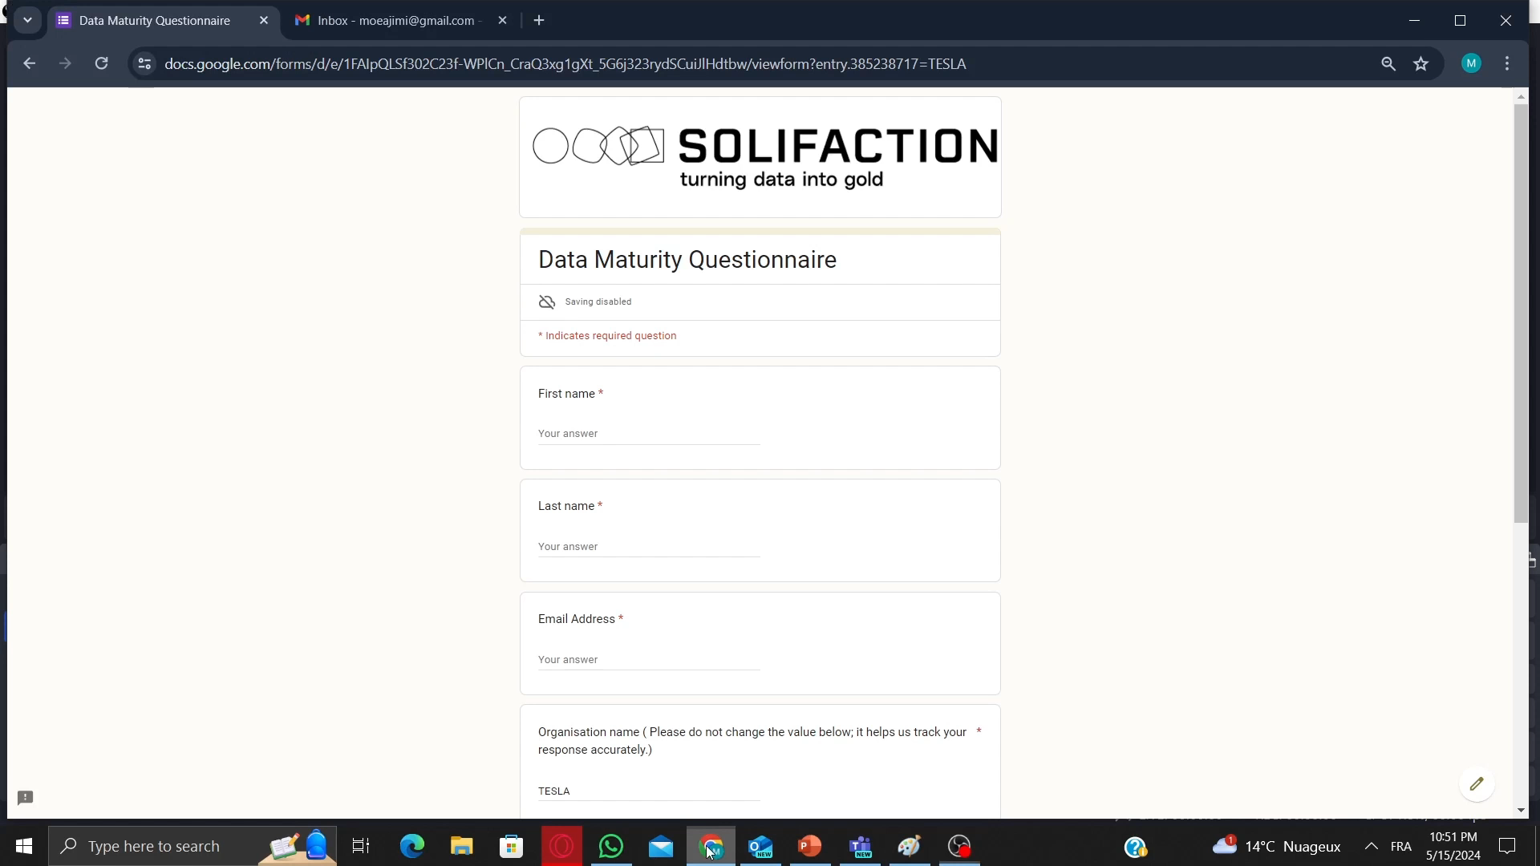
7

Slide 8
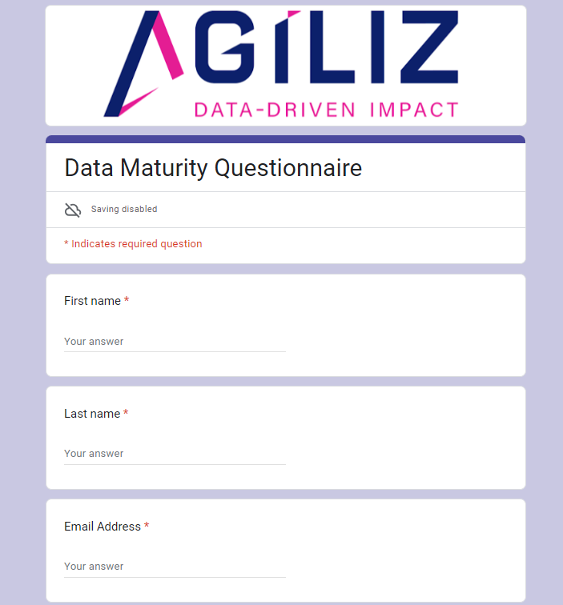
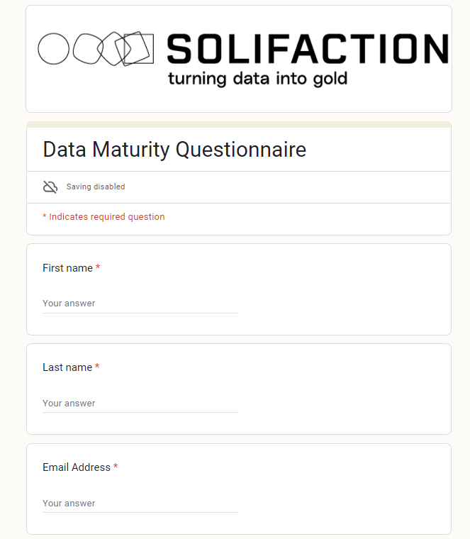
Google Form
9

Slide 9
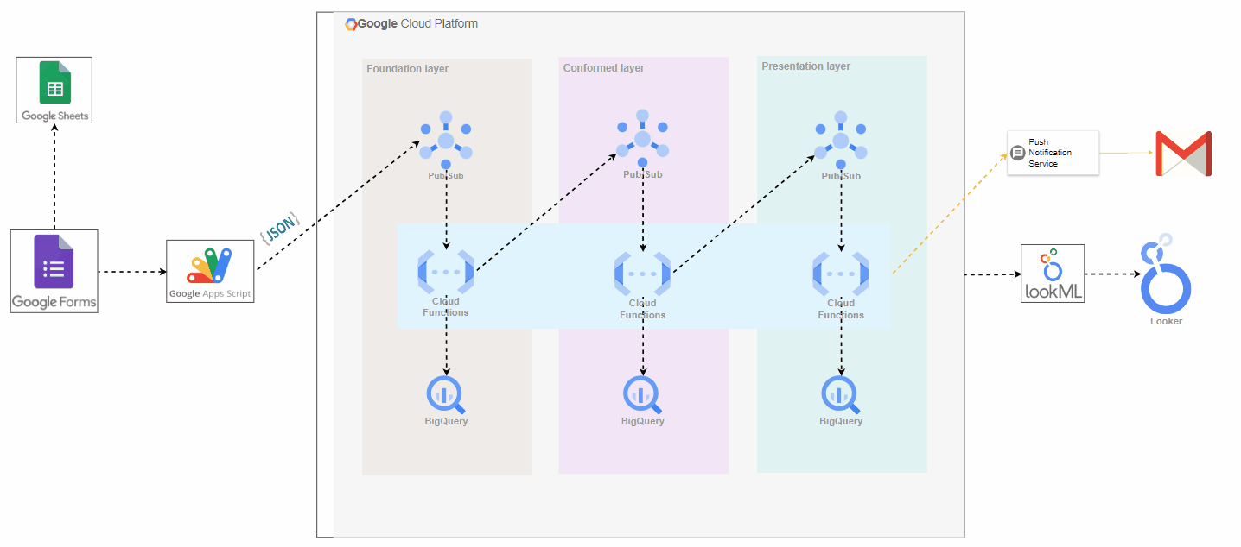
Pipeline Architecture
11

Slide 10
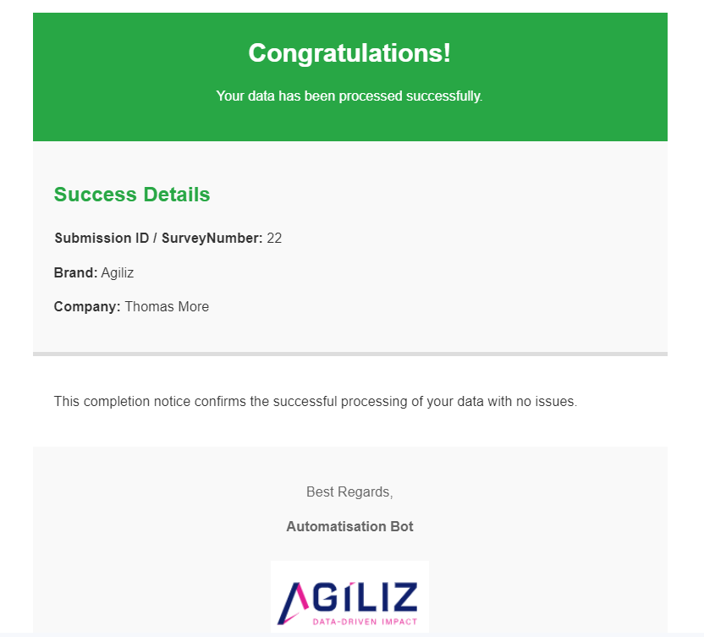
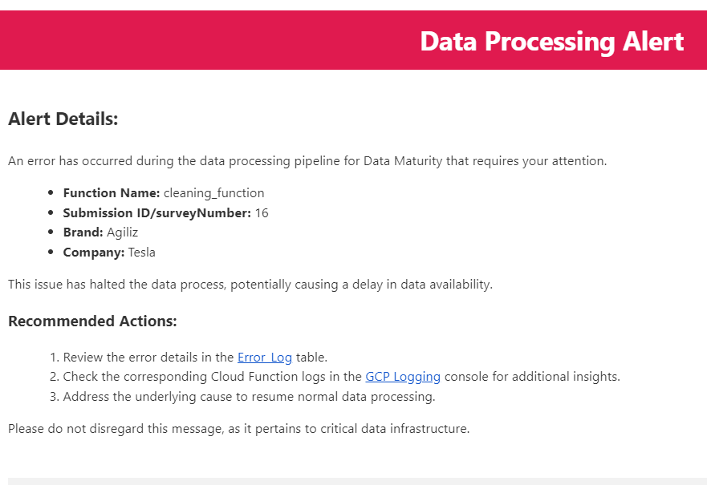
Email Notification System
12

Slide 11
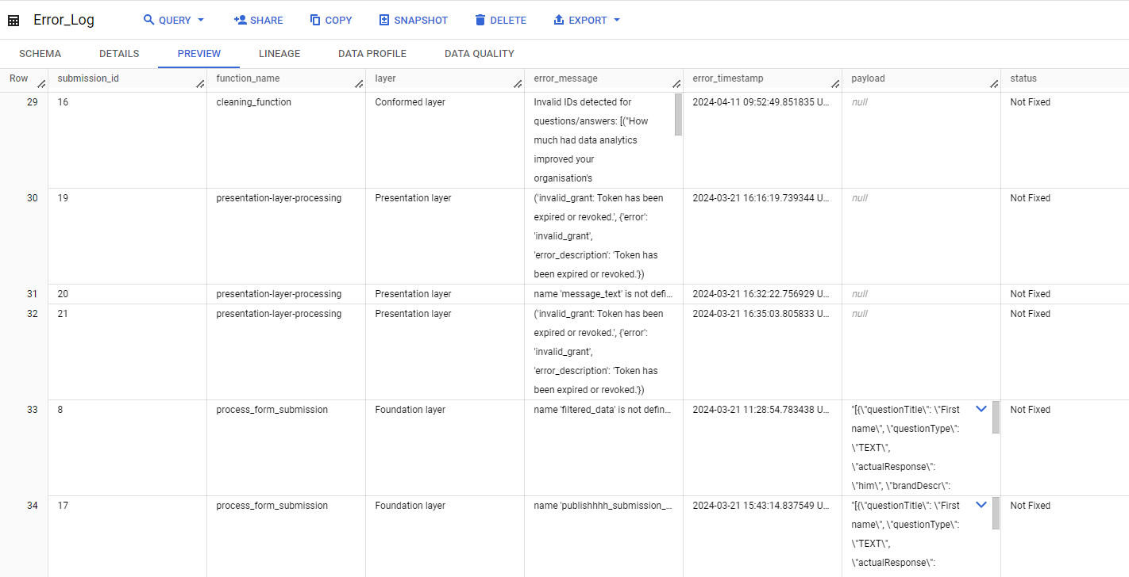
12

Slide 12
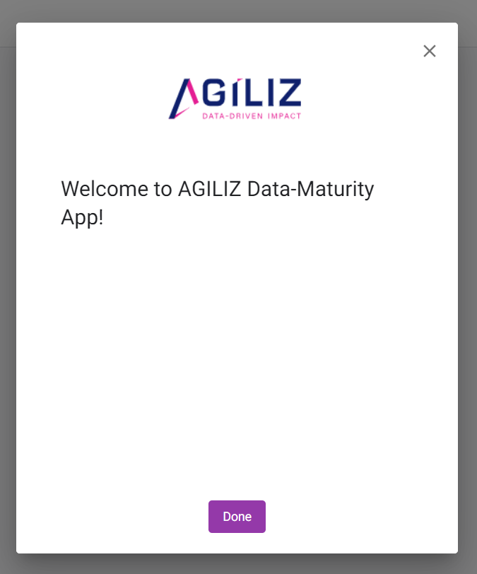
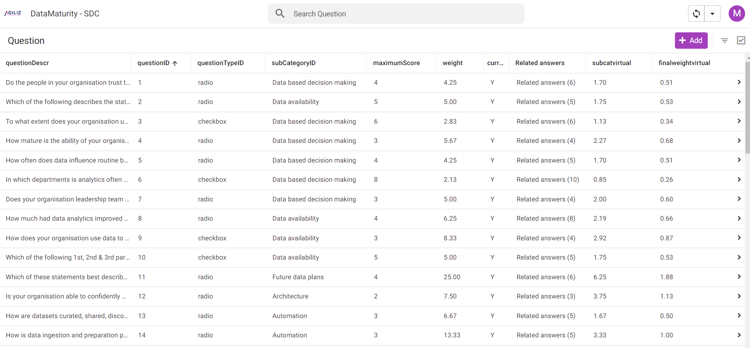
Updating the survey (SCD)
13

Slide 13
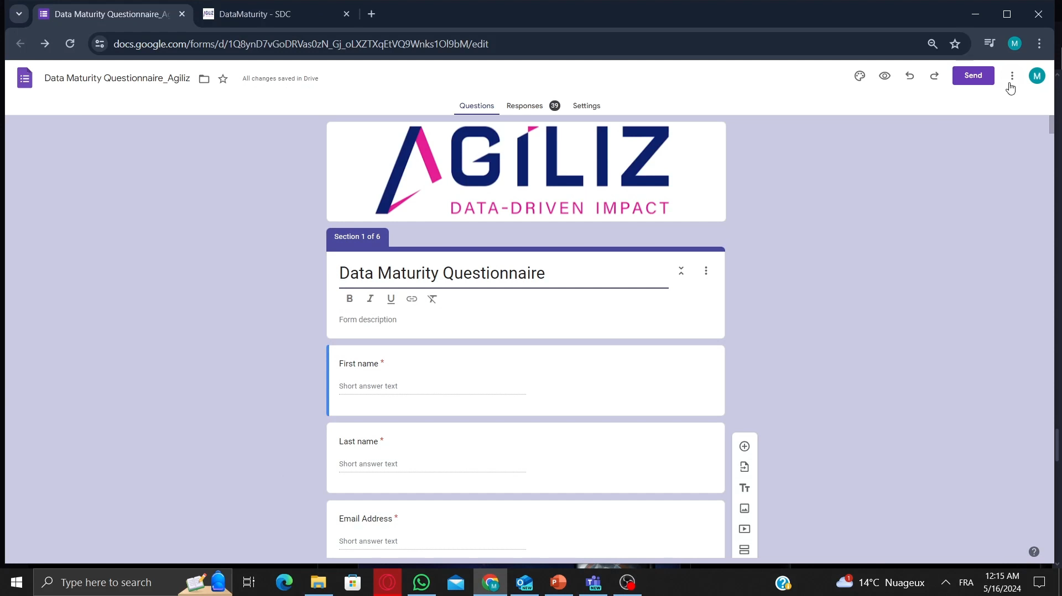
13

Slide 14
03
GCP Cost
15

Slide 15
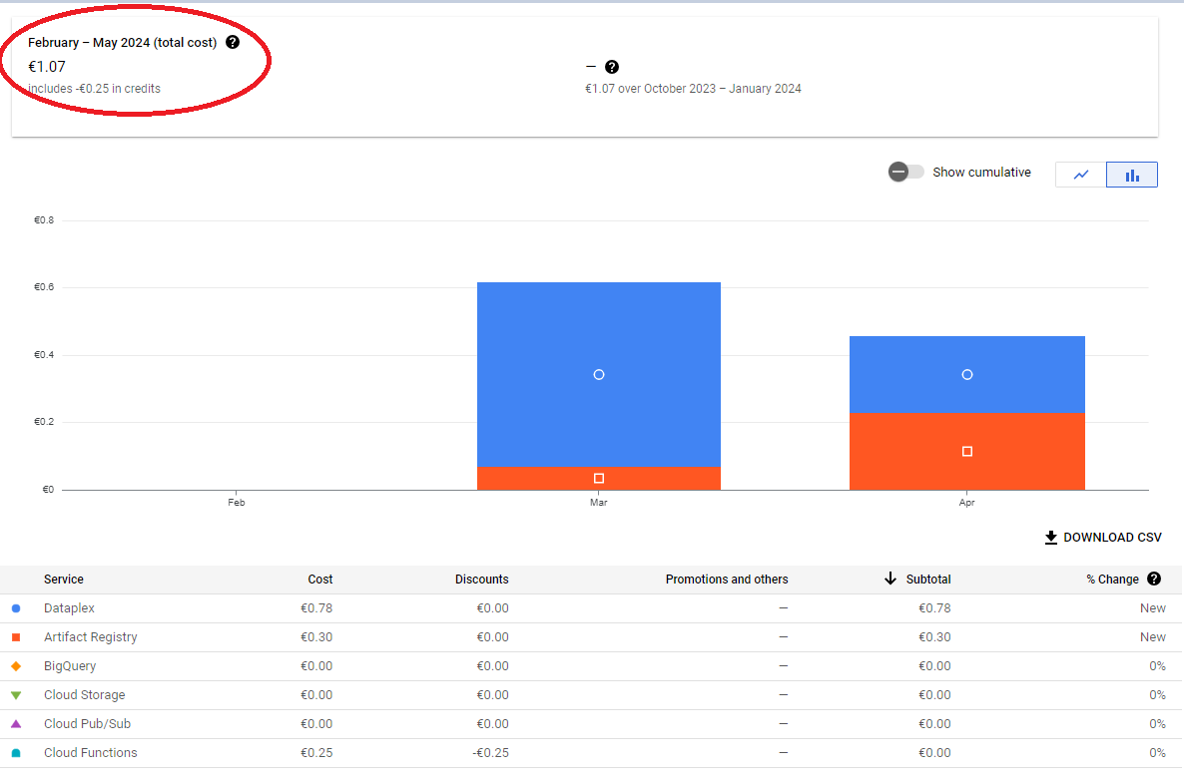
15

Slide 16
04
Dashboard
15

Slide 17
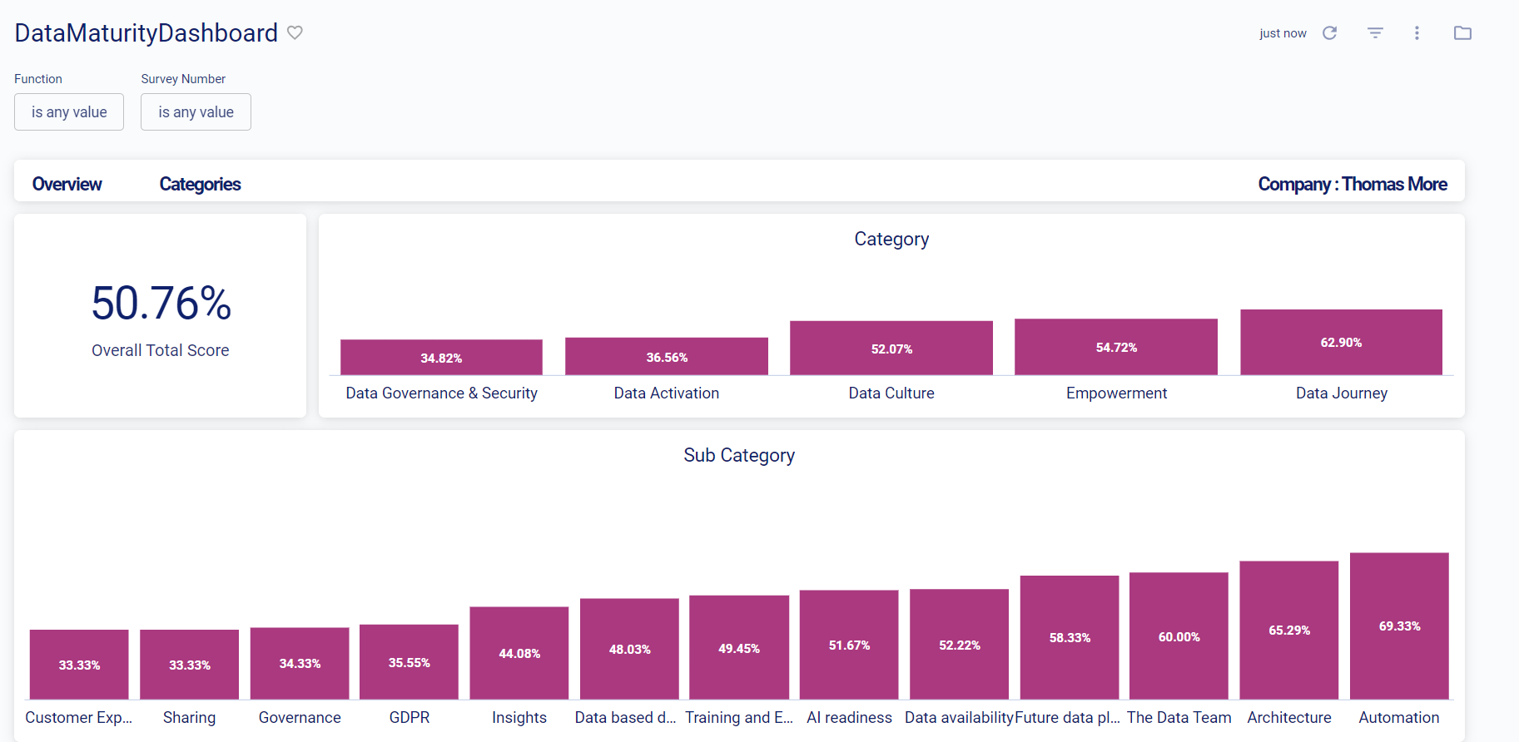
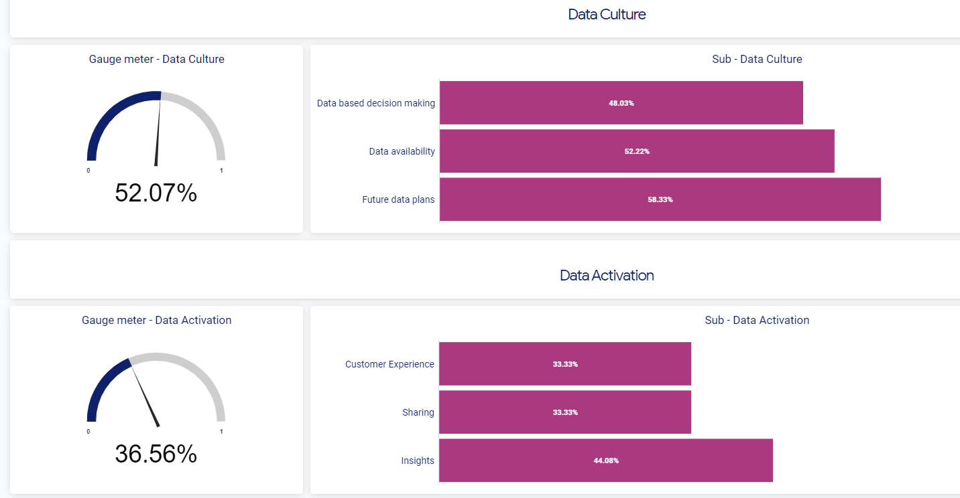
Dashboard
14

Slide 18
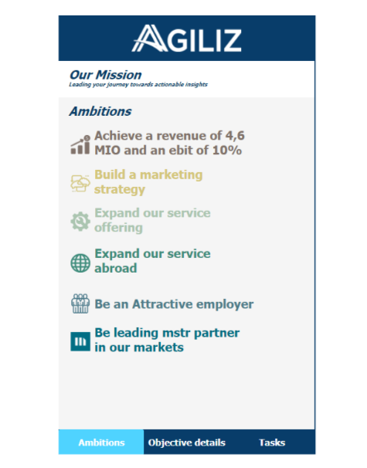
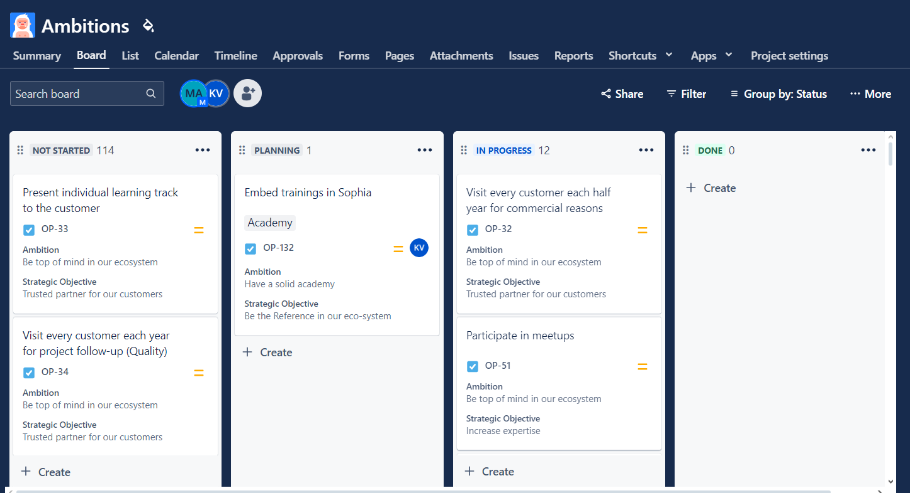
Other projects
14

Slide 19

Thanks!
Do you have any questions?
mohamed.ajimi@agiliz.com
17

